Slide 1
Module 5
Operating System Security

Slide 2
Memory and Address Protection
The most obvious problem of multiprogramming is preventing one program from affecting the data and programs in the memory space of other users.
Protection can be built into d h/w mechnsms that cntrl efcient use of mmry. So solid prtction can be provided @ essentialy no aditional cost.
Fence
Relocation
Base/Bound Registers
Tagged architecture
Segmentation
Paging
Combined paging with segmentation

Slide 3
Fence
Prevent a faulty user program from destroying part of the resident portion of the operating system.
Fence is a method to confine users to one side of a boundary.
In one implementation, the fence was a predefined memory address, enabling the operating system to reside on one side and the user to stay on the other. (eg->)

Slide 4
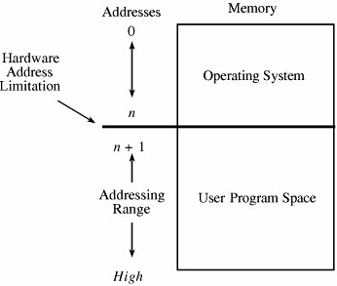
Fixed Fence

Slide 5
Fence
Another implementation used a hardware register, often called a fence register, containing the address of the end of the operating system.
In this scheme the location of the fence could be changed.
Each time a user program generated an address for data modification, the address was automatically compared with the fence address.
If the address was greater than the fence address (that is, in the user area), the instruction was executed;
If it was less than the fence address (that is, in the operating system area), an error condition was raised.

Slide 6
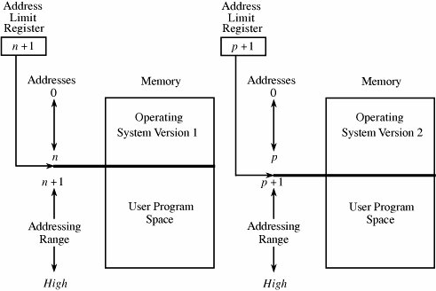
Variable Fence Register

Slide 7
Relocation
Relocation is the process of taking a program written as if it began at address 0 and changing all addresses to reflect the actual address at which the program is located in memory.
In many instances, this effort merely entails adding a constant relocation factor to each address of the program.
That is, the relocation factor is the starting address of the memory assigned for the program.

Slide 8
Base/Bounds Registers
The relocation register solves the problem by providing a base or starting address.
All addresses inside a program are offsets from that base address.
A variable fence register is generally known as a base register.

Slide 9
Base/Bounds Registers
Fence registers provide a lower bound (a starting address) but not an upper one.
An upper bound can be useful in knowing how much space is allotted and in checking for overflows into "forbidden" areas.
To overcome this difficulty, a second register is often added called a bounds register, is an upper address limit, in the same way that a base or fence register is a lower address limit.
Each program address is forced to be above the base address because the contents of the base register are added to the address; each address is also checked to ensure that it is below the bounds address.

Slide 10
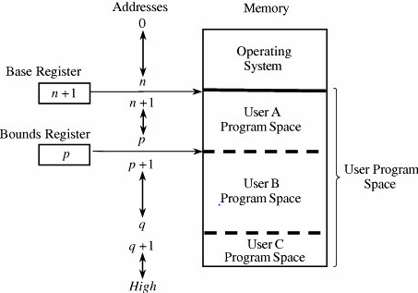
Pair of Base/Bound Registers

Slide 11
Base/Bounds Registers
When execution changes from one user's program to another's, the operating system must change the contents of the base and bounds registers to reflect the true address space for that user.
We can solve the overwriting problem by using another pair of base/bounds registers, one for the instructions (code) of the program and a second for the data space.
Then, only instruction fetches (instructions to be executed) are relocated and checked with the first register pair, and only data accesses (operands of instructions) are relocated and checked with the second register pair.

Slide 12
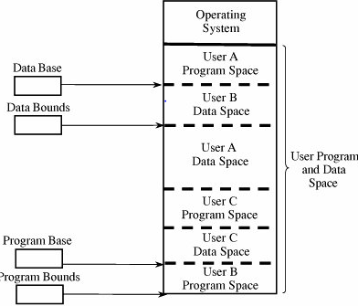
Two Pairs of Base/Bound Registers

Slide 13
Tagged Architecture
User may want to protect some data values but not all.
In tagged architecture, in which every word of machine memory has one or more extra bits to identify the access rights to that word.
These access bits can be set only by privileged (operating system) instructions.
The bits are tested every time an instruction accesses that location.

Slide 14
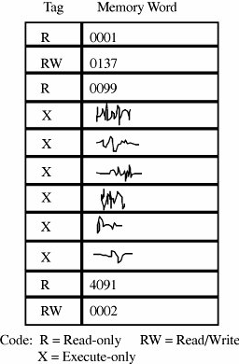
Tagged Architecture

Slide 15
Segmentation
Segmentation, involves the simple notion of dividing a program into separate pieces.
Each piece has a logical unity, exhibiting a relationship among all of its code or data values.
Segmentation allows a program to be divided into many pieces having different access rights.

Slide 16
Segmentation
Each segment has a unique name.
A code or data item within a segment is addressed as the pair <name, offset>, where name is the name of the segment containing the data item and offset is its location within the segment (that is, its distance from the start of the segment).
Logically, the programmer pictures a program as a long collection of segments.
Segments can be separately relocated, allowing any segment to be placed in any available memory locations.

Slide 17
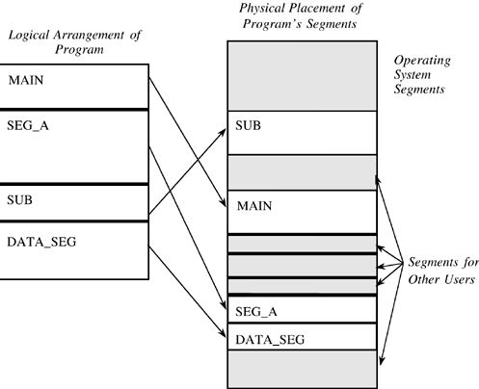
Logical and Physical Representation of Segments.

Slide 18
Segmentation
The operating system must maintain a table of segment names and their true addresses in memory.
When a program generates an address of the form <name, offset>, the operating system looks up name in the segment directory and determines its real beginning memory address.
To that address the operating system adds offset, giving the true memory address of the code or data item.
For efficiency there is usually one operating system segment address table for each process in execution.
Two processes that need to share access to a single segment would have the same segment name and address in their segment tables.

Slide 19
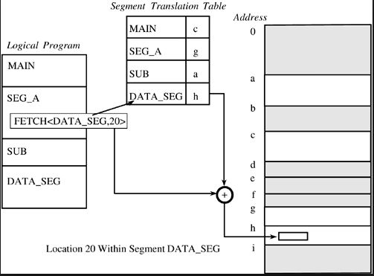
Translation of Segment Address

Slide 20
Segmentation
A user's program does not know what true memory addresses it uses.
This hiding of addresses has three advantages for the operating system.
The operating system can place any segment at any location or move any segment to any location, even after the program begins to execute.
A segment can be removed from main memory (and stored on an auxiliary device) if it is not being used currently.
Every address reference passes through the operating system, so there is an opportunity to check each one for protection.

Slide 21
Segmentation
Segmentation offers these security benefits:
Each address reference is checked for protection.
Many different classes of data items can be assigned different levels of protection.
Two or more users can share access to a segment, with potentially different access rights.
A user cannot generate an address or access to an unpermitted segment.

Slide 22
Segmentation
One protection difficulty inherent in segmentation concerns segment size.
Each segment has a particular size.
However, a program can generate a reference to a valid segment name, but with an offset beyond the end of the segment.

Slide 23
Segmentation
Efficient implementation of segmentation presents two problems:
Segment names are inconvenient to encode in instructions.
The operating system's lookup of the name in a table can be slow.
To overcome these difficulties, segment names are often converted to numbers by the compiler when a program is translated; the compiler also appends a linkage table matching numbers to true segment names.

Slide 24
Paging
The program is divided into equal-sized pieces called pages, and memory is divided into equal-sized units called page frames.
Each address in a paging scheme is a two-part object, this time consisting of <page, offset>.

Slide 25
Paging
The operating system maintains a table of user page numbers and their true addresses in memory.
The page portion of every <page, offset> reference is converted to a page frame address by a table lookup; the offset portion is added to the page frame address to produce the real memory address of the object referred to as <page, offset>.

Slide 26
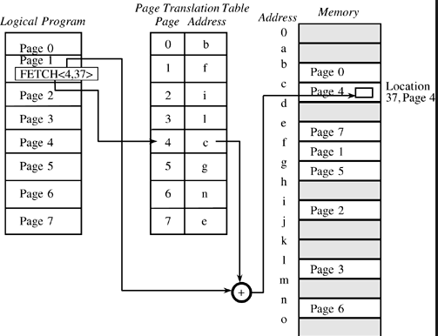
Page Address Translation

Slide 27
Paging
All pages in the paging approach are of the same fixed size, so fragmentation is not a problem.
Each page can fit in any available page in memory, and thus there is no problem of addressing beyond the end of a page.

Slide 28
Combined Paging with Segmentation
Paging offers implementation efficiency, while segmentation offers logical protection characteristics.
Multics operating system (implemented on a GE-645 machine) applied paging on top of segmentation.
In both cases, the programmer could divide a program into logical segments.
Each segment was then broken into fixed-size pages.
In Multics, the segment name portion of an address was an 18-bit number with a 16-bit offset.
The addresses were then broken into 1024-byte pages.

Slide 29
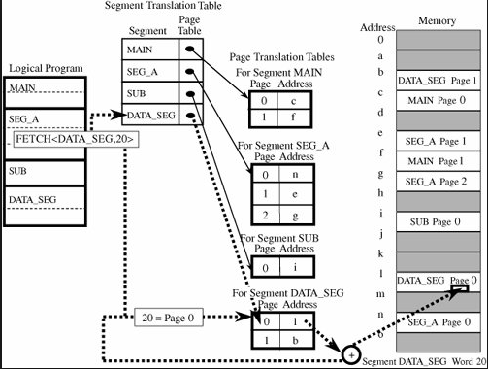
Paged Segmentation

Slide 30
Control of Access to General Objects
Protecting memory is a specific case of the more general problem of protecting objects.
Kinds of objects
Memory
A file or data set on an auxiliary storage device
An executing program in memory
A directory of files
A hardware device
A data structure
A table of the operating system
Privileged instructions
Passwords
Protection mechanism
There are several complementary goals in protecting objects.
Check every access
Enforce least privilege
Verify acceptable usage

Slide 31
Control of Access to General Objects
Directory
Access control list
Access control matrix
Capability
Kerberos
Procedure oriented access control
Role based access control

Slide 32
Directory
Every file has a unique owner who possesses "control" access rights and to revoke access to any person at any time.
Each user has a file directory, which lists all the files to which that user has access.
The operating system must maintain all file directories, under commands from the owners of files.
The obvious rights to files are the common read, write, and execute familiar on many shared systems.
Another right, owner, is possessed by the owner, permitting that user to grant and revoke access rights.

Slide 33
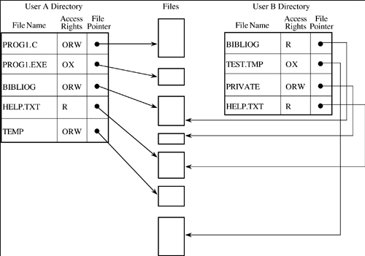
Directory Access

Slide 34
Directory
This approach is easy to implement because it uses one list per user, naming all the objects that user is allowed to access.
Difficulties
The list becomes too large if many shared objects, such as libraries of subprograms or a common table of users, are accessible to all users.
Revocation of access
Pseudonyms

Slide 35
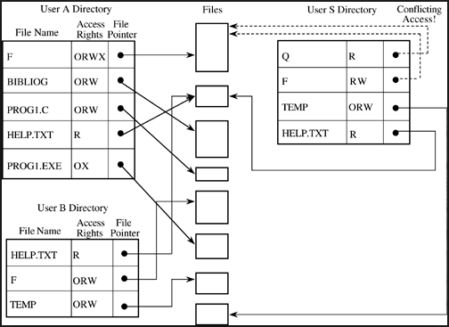
Alternative Access Paths

Slide 36
Access Control List
An alternative representation is the access control list.
There is one such list for each object, and the list shows all subjects who should have access to the object and what their access is.
This approach differs from the directory list because there is one access control list per object; a directory is created for each subject.

Slide 37
Access Control List
The Multics operating system used a form of access control list in which each user belonged to three protection classes: a user, a group, and a compartment.
The user designation identified a specific subject.
The group designation brought together subjects who had a common interest, such as coworkers on a project.
The compartment confined an untrusted object; a program executing in one compartment could not access objects in another compartment without specific permission.
The compartment was also a way to collect objects that were related, such as all files for a single project.

Slide 38
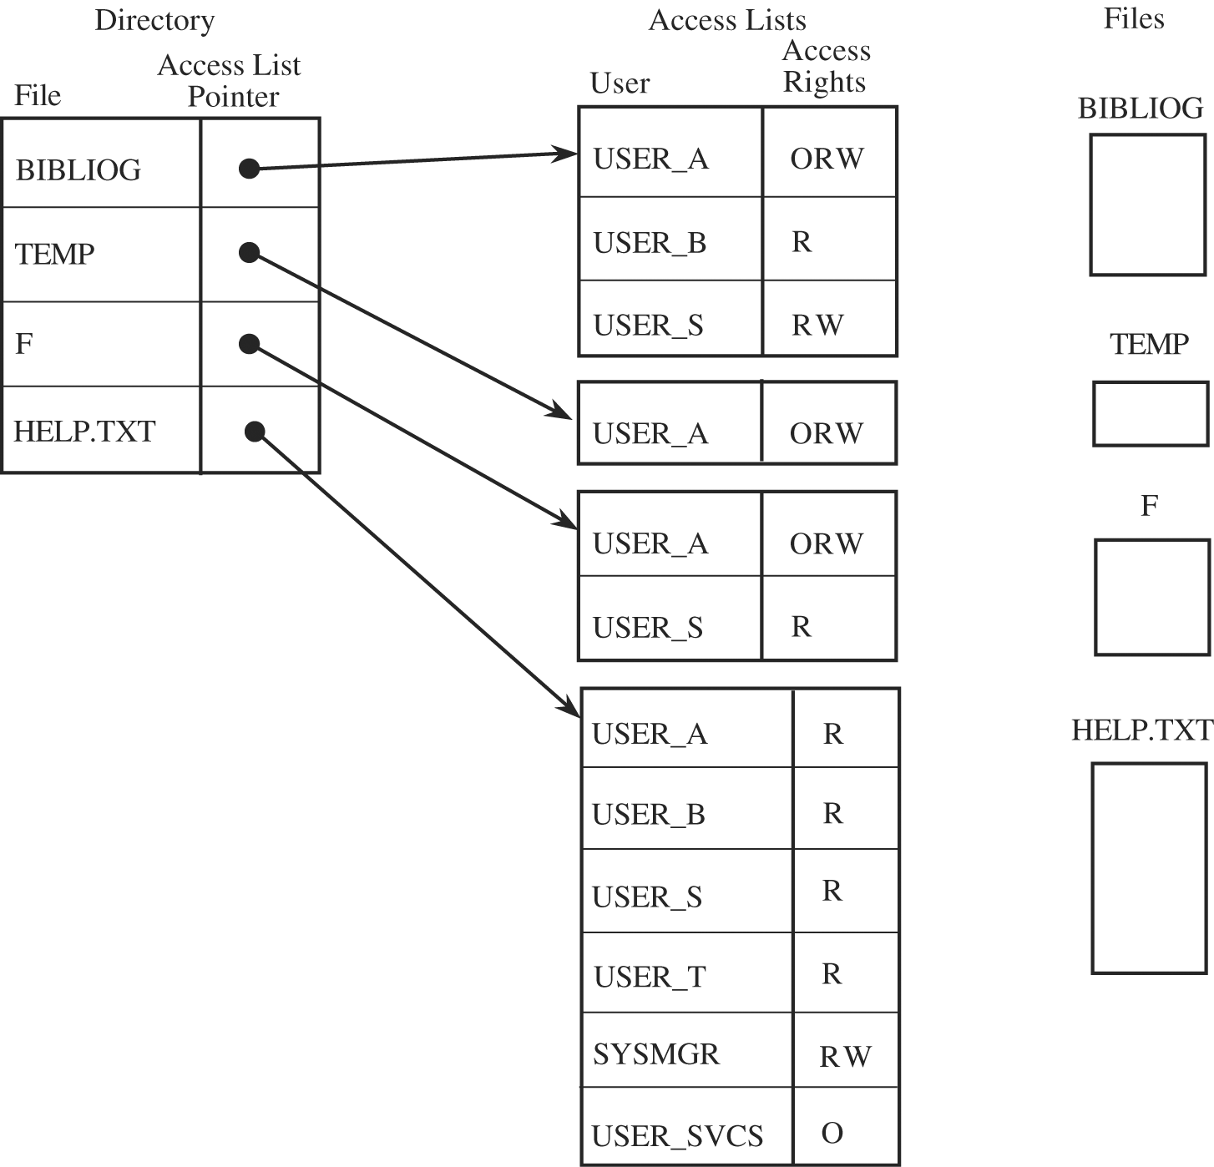
Access Control List

Slide 39
Access Control List
This kind of mechanism would be too restrictive to be usable.
The solution is the use of wild cards, meaning placeholders that designate "any user“.
The access control list can be maintained in sorted order, with * sorted as coming after all specific names.

Slide 40
Access Control Matrix
A table in which each row represents a subject, each column represents an object, and each entry is the set of access rights for that subject to that object.
In general, the access control matrix is sparse (meaning that most cells are empty):
Most subjects do not have access rights to most objects.
The access matrix can be represented as a list of triples, having the form <subject, object, rights>.

Slide 41
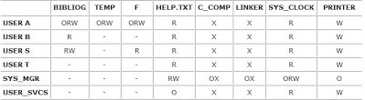
Access Control Matrix

Slide 42
Capability
A capability is a ticket giving permission to a subject to have a certain type of access to an object.
The operating system returns to the user a pointer to an operating system data structure, which also links to the user.
A capability can be created only by a specific request from a user to the operating system.
Each capability also identifies the allowable accesses.

Slide 43
Capability
Alternatively, capabilities can be encrypted under a key available only to the access control mechanism.
One possible access right to an object is transfer or propagate.
A subject having this right can pass copies of capabilities to other subjects.

Slide 44
Capability
As a process executes, it operates in a domain or local name space.
The domain is the collection of objects to which the process has access.
Each capability identifies a single object in a domain, the collection of capabilities defines the domain.
Capabilities must be stored in memory inaccessible to normal users.
During execution, only the capabilities of objects that have been accessed by the current process are kept readily available.
Capabilities can be revoked.

Slide 45
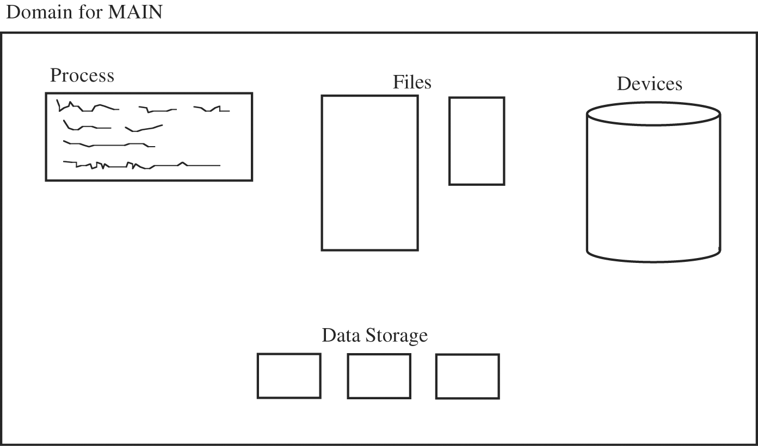
Process Execution Domain

Slide 46
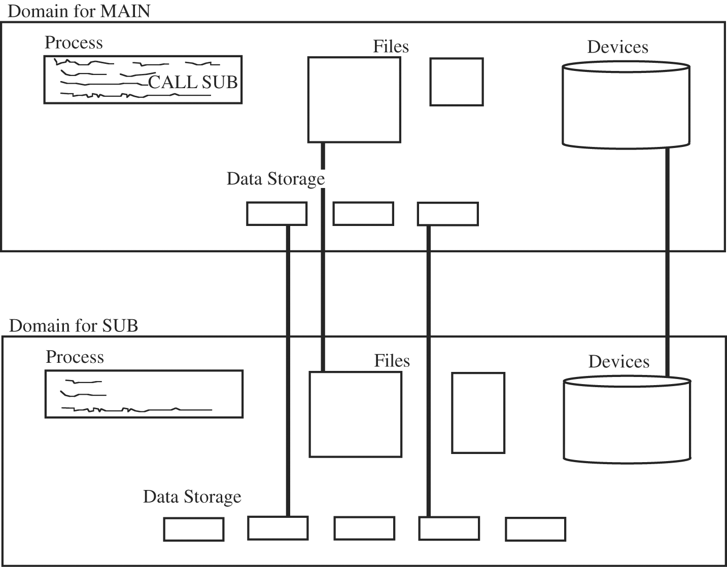
Passing Objects to a Subject

Slide 47
Kerberos
Kerberos implements both authentication and access authorization by means of capabilities, called tickets, secured with symmetric cryptography.
Kerberos requires two systems, called the authentication server (AS) and the ticket-granting server (TGS), which are both part of the key distribution center (KDC).
Kerberos implements single sign-on; that is, a user signs on once and from that point on all the user's (allowable) actions are authorized without the user needing to sign on again.
Kerberos accomplishes its local and remote authentication and authorization with a system of shared secret encryption keys.

Slide 48
Procedure-Oriented Access Control
Procedure-oriented protection imply the existence of a procedure that controls access to objects.
Procedures can ensure that accesses to an object be made through a trusted interface.
Neither users nor general operating system routines might be allowed direct access to the table of valid users.
Instead, the only accesses allowed might be through three procedures: one to add a user, one to delete a user, and one to check whether a particular name corresponds to a valid user.
Procedure-oriented protection implements the principle of information hiding because the means of implementing an object are known only to the object's control procedure.

Slide 49
Role-Based Access Control
We have not yet distinguished among kinds of users, but we want some users (such as administrators) to have significant privileges, and we want others (such as regular users or guests) to have lower privileges.
Role-based access control lets us associate privileges with groups, such as all administrators can do this or candlestick makers are forbidden to do this.

Slide 50
File Protection Mechanisms
Basic Forms of Protection
All-None Protection
Group Protection
Single Permissions
Password or Other Token
Temporary Acquired Permission
Per-Object and Per-User Protection

Slide 51
All-None Protection
Files were by default public.
The system administrator could protect them with a password.
Sometimes, passwords controlled all accesses (read, write, or delete), giving the system administrator complete control over all files.
But at other times passwords controlled only write and delete accesses because only these two actions affected other users.

Slide 52
All-None Protection
All-or-none protection is unacceptable for several reasons
Lack of trust
All or nothing
Rise of timesharing
Complexity
File listings

Slide 53
Group Protection
All authorized users are separated into groups.
A group may consist of several members working on a common project, a department, a class, or a single user.
The basis for group membership is need to share.
The group members have some common interest and therefore are assumed to have files to share with the other group members.
In this approach, no user belongs to more than one group.

Slide 54
Group Protection
When creating a file, a user defines access rights to the file for the user, for other members of the same group, and for all other users in general.
For a particular file, a user might declare read-only access to the general world, read and update access to the group, and all rights to the user.
A key advantage of the group protection approach is its ease of implementation.
A user is recognized by two identifiers (usually numbers): a user ID and a group ID.
These identifiers are stored in the file directory entry for each file and are obtained by the operating system when a user logs in.

Slide 55
Group Protection
Although this protection scheme overcomes some of the shortcomings of the all-or-nothing scheme, it introduces some new difficulties of its own.
Group affiliation
Multiple personalities
All groups
Limited sharing

Slide 56
Single Permissions
Provide finer degrees of security while associating permission with a single file.

Slide 57
Password or Other Token
Allowing a user to assign a password to a file.
User accesses are limited to those who can supply the correct password at the time the file is opened.
Difficulties
Loss
Use
Disclosure
Revocation

Slide 58
Temporary Acquired Permission
Unix+ operating systems provide a permission scheme based on a three-level user group world hierarchy.
The Unix designers added a permission called set userid (suid).
If this protection is set for a file to be executed, the protection level is that of the file's owner, not the executor.
This mechanism is convenient for system functions that general users should be able to perform only in a prescribed way.

Slide 59
Per-Object and Per-User Protection
The primary limitation of these protection schemes is the ability to create meaningful groups of related users who should have similar access to related objects.
The access control lists or access control matrices described earlier provide very flexible protection.

Slide 60
Bell-La Padula Confidentiality Model
The Bell and La Padula model is a formal description of the allowable paths of information flow in a secure system.
The model's goal is to identify allowable communication when maintaining secrecy is important.
The model has been used to define security requirements for systems concurrently handling data at different sensitivity levels.
It is a formalization of the military security policy.

Slide 61
Bell-La Padula Confidentiality Model
Consider a security system with the following properties.
The system covers a set of subjects S and a set of objects O.
Each subject s in S and each object o in O has a fixed security class C(s) and C(o).
The security classes are ordered by a relation ≤ .

Slide 62
Bell-La Padula Confidentiality Model
Two properties characterize the secure flow of information.
Simple Security Property
A subject s may have read access to an object o only if C(o) ≤ C(s).
*-Property (called the "star property")
A subject s who has read access to an object o may have write access to an object p only if C(o)≤ C(p).

Slide 63
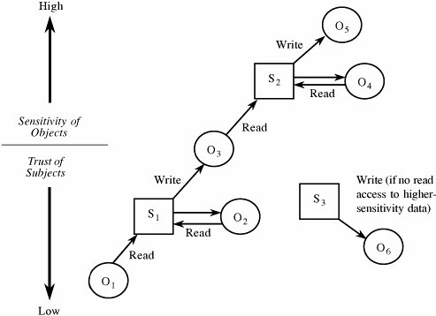
Secure Flow of Information

Slide 64
Secure Flow of Information
The classifications of subjects (represented by squares) and objects (represented by circles) are indicated by their positions.
As the classification of an item increases, it is shown higher in the figure.
The flow of information is generally horizontal (to and from the same level) and upward (from lower levels to higher).
A downward flow is acceptable only if the highly cleared subject does not pass any high-sensitivity data to the lower-sensitivity object.

Slide 65
Biba Integrity Model
The Biba model is the counterpart (sometimes called the dual) of the Bell-La Padula model.
This model identifies paths that could lead to inappropriate disclosure of information.
Biba defines "integrity levels," which are analogous to the sensitivity levels of the Bell-La Padula model.
Subjects and objects are ordered by an integrity classification scheme, denoted I(s) and I(o).

Slide 66
Biba Integrity Model
The properties are
Simple Integrity Property
Subject s can modify (have write access to) object o only if I(s) ≥ I(o)
Integrity *-Property
If subject s has read access to object o with integrity level I(o), s can have write access to object p only if I(o) ≥ I(p)

